Slide 1
Big Mountain Resort
Recommendations for a Data Driven Business Strategy

Slide 2
The problem
Cutting Costs and/or Increasing Ticket Price
Big Mountain Resort is looking to effectively develop and implement a new pricing strategy that can maximize their facilities investments to offset their recent additional operating cost by $1.54M this season.

Slide 3
Recommendations
Recommendation 1
Recommendation 2
Recommendation 3
Increasing the vertical drop by 150 ft would increase the ticket price by 10.44% from $81.00 to $89.46, resulting in a revenue increase of $14,811,594.
Adding 2 acres of snow making would increase the ticket price by 12% from $81.00 to $90.75, resulting in a revenue increase of $17,068,841.
Add 1 chair lift and 1 run. Because we don’t know the operating cost per used run, we can’t determine how much cost saving will offset the loss in revenue after closing more than one run.

Slide 4
Scenario 1
According to our modeling, closing one run makes no difference. Closing 2 and 3 successively reduces support for ticket price and so revenue. If Big Mountain closes down 3 runs, it seems they may as well close down 4 or 5 as there's no further loss in ticket price. Increasing the closures down to 6 or more leads to a large drop.
Close up to 10 of the least used runs. The number of runs is the only parameter varying.

Slide 5
Scenario 2
This scenario increases support for ticket price by $8.61. Over the season, this could be expected to amount to $15,065,471.
Add 1 run, increase the vertical drop by 150 feet, and install an additional chair lift.

Slide 6
Scenario 3
This scenario increases support for ticket price by $9.90. Over the season, this could be expected to amount to $17,322,717. Such a small increase in the snow making area makes no difference!
Add 1 run, increase the vertical drop by 150 feet, and install an additional chair lift.
Additionally, add 2 acres of snow making.

Slide 7
Scenario 3
This model resorted in no difference whatsoever. Although the longest run feature was used in the linear model, the random forest model only has longest run way down in the feature importance list.
Increase the longest run by 0.2 miles and guarantee its snow coverage by adding 4 acres of snow making.

Slide 8
Conclusion
The best scenario for Big Mountain Resort is to increase the vertical drop by 150 ft, add 1 chair lift, add 1 run and add 2 acres of snow making cover. This scenario increases the ticket price by 12% from $81.00 to $90.75, resulting in a bottom line increase of $15,528,841 ($1.54M after deducting operating costs).

Slide 9
Appendix

Slide 10
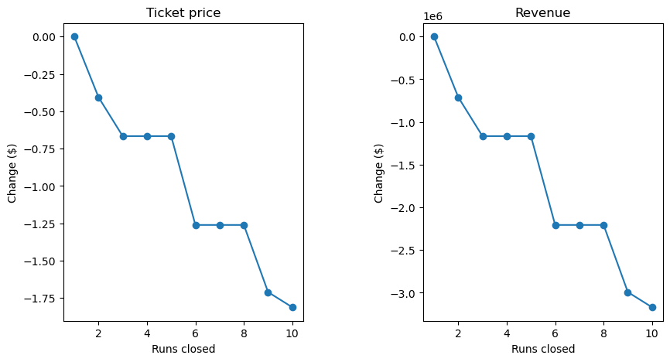
Scenario 1: Closing Runs

Slide 11
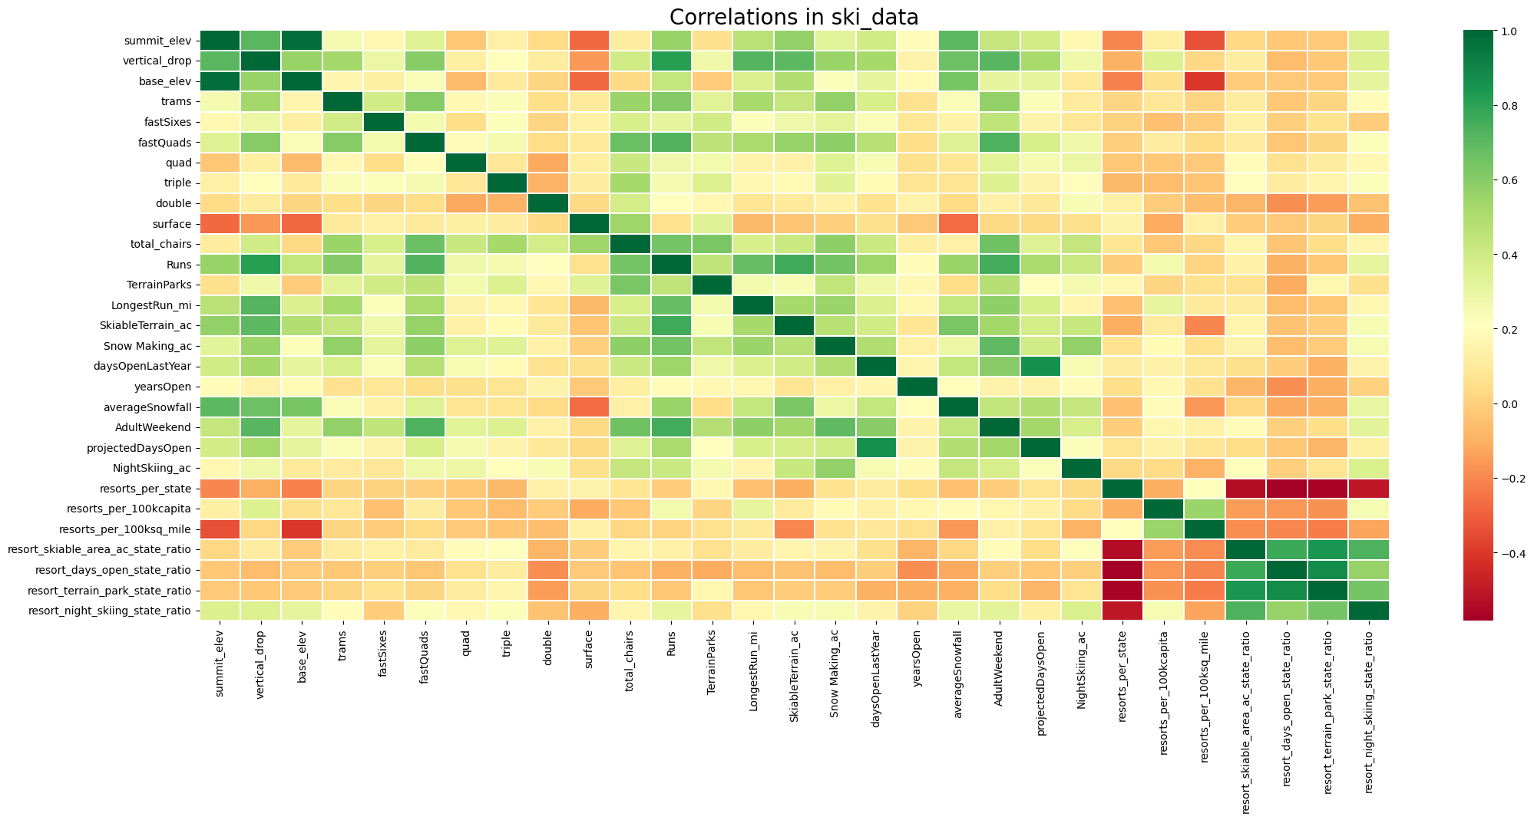
Feature Correlation Heatmap

Slide 12
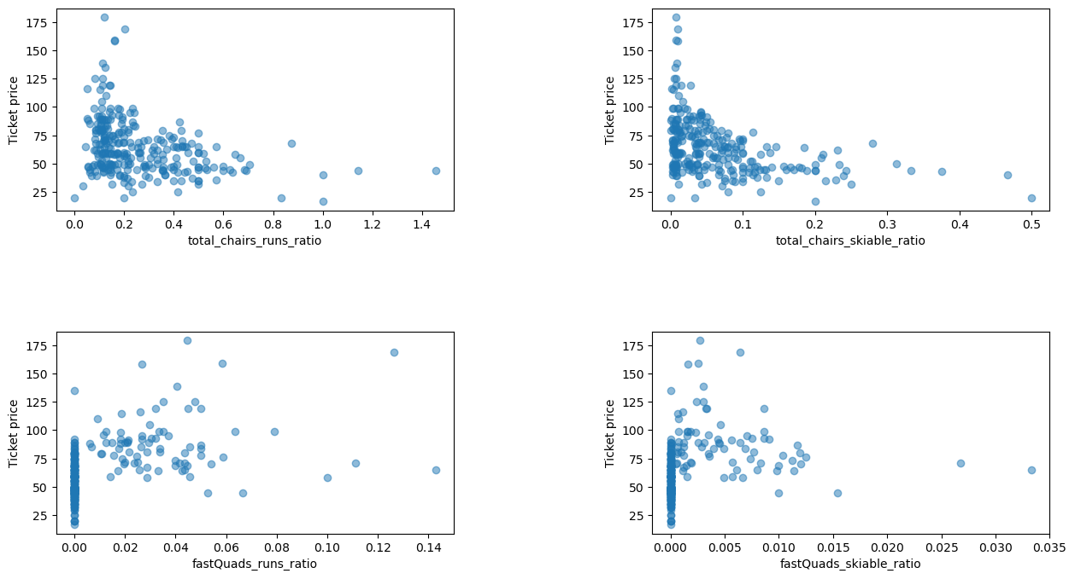
Features Against Ticket Price

Slide 13
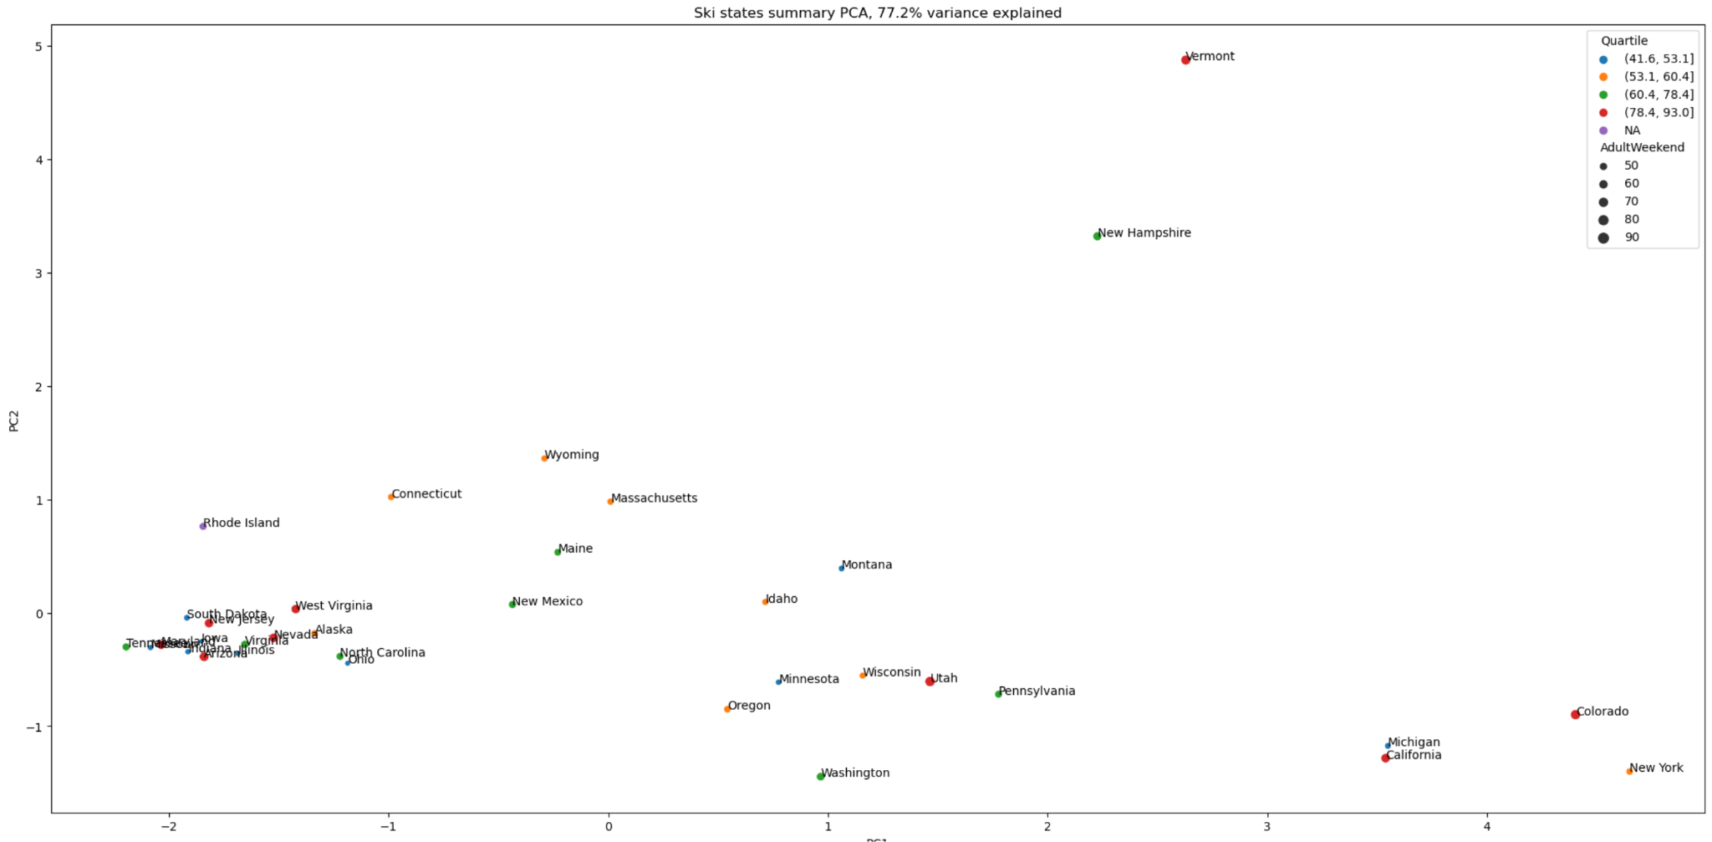
State and Ticket Price

